Slide 1
DEPARTMENT OF
COMPUTER SCIENCE & ENGINEERING(Data Science)
“Sentiment Analysis of Financial Market”
M I N I P R O J E C T
RESULT SEMINAR
PROJECT GUIDE: Dr. Manish Gudadhe
PROJECT MEMBERS:
1)Tarandeep Plaha
2)Sahil Bhusari
3)Solomon Alexander
4)Kaustubh Mate
DATE: 10/05/24

Slide 2
Introduction:
Design and develop a sentiment analysis system assisted with technical and fundamental analysis techniques for the financial market that can accurately assess the sentiment of news articles other textual data related to financial assets (stocks, commodities, etc.) in real-time.
Sentiment analysis in the financial market, particularly in the stock market, involves analyzing and interpreting sentiments expressed in various sources like news articles, social media, and financial reports to gain insights into investor opinions and market trends. This analysis plays a crucial role in predicting stock market movements by understanding the sentiment conveyed in texts.

Slide 3
Problem Statement:
The financial markets are influenced by a multitude of factors, including economic indicators, company performance, market sentiment, and technical analysis signals. However, accurately analysis the market movements remains a challenge due to the complexity and volatility inherent in financial markets.
AIM:
The primary aim of sentiment analysis in the stock market is to project market movements by leveraging sentiment data extracted from different sources like news headlines, social media comments, and financial reports. This analysis helps investors and analysts anticipate stock price fluctuations based on the sentiment expressed in textual data.

Slide 4
Objectives:
Building a Real Time Dashboard:
To build a real-time dashboard, the primary objective is to create a dynamic and interactive platform that provides up-to-date information and visualizations for monitoring key metrics or data points continuously. This dashboard aims to offer real-time insights, facilitate quick decision-making, and enhance overall situational awareness by displaying live data in a user-friendly and easily accessible format.

Slide 5
Languages and Platform Used:
Python
NLP(Natural Language Processing)
Vscode

Slide 6
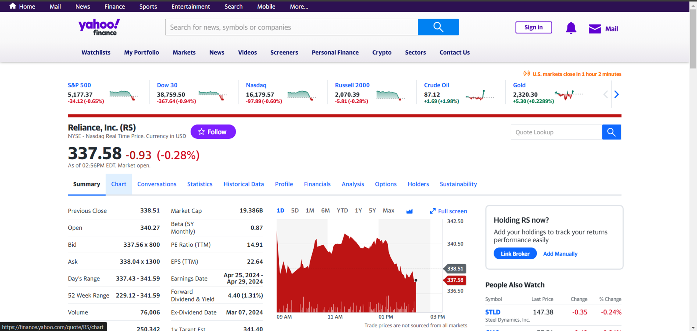
DATA SOURCE:-
Yahoo! Finance : (live data)
Yahoo Finance is a rich resource of financial market data and tools to find compelling investments. Explore your options for finding and analyzing data.

Slide 7
Dashboard Components:
Fundamental Analysis
Fundamental analysis of stocks evaluates a company's financial health, management, competitive position, and industry trends to determine its intrinsic value and investment potential.
2) Technical Analysis
Technical analysis of stocks involves analyzing price and volume data using charts and statistical tools to forecast future price movements based on historical patterns and market trends.
3) Sentiment analysis
Sentiment analysis of stocks examines public sentiment, such as news articles, social media posts, and investor sentiment indicators, to gauge market sentiment and potential market direction.

Slide 8
:
Use Cases and Benefits:
Helps traders make informed decisions based on historical price movements and patterns.
Enables investors to identify undervalued or overvalued stocks based on a company's financial health and growth potential.
Provides insights into market mood and potential crowd behavior, enhancing decision-making in trading and investing.

Slide 9
Dashboard Features:
Visualization : Interactive charts with zoom and filter options for detailed analysis.
Candlestick graph : In stocks visually represents price movement over a period, with each candlestick showing opening, closing, high, and low prices, aiding in trend analysis.

Slide 10
Performance & Scalability:
Low latency data updates for real-time analysis and decision-making. Efficient data processing and calculation algorithms for responsive dashboard performance.
Can be used for any stock of any company of any stock exchange of the world.

Slide 11
Training Resources:
Online tutorials, user guides, and video tutorials for dashboard navigation and analysis. Webinars and workshops for advanced usage and strategies in stock analysis.

Slide 12
Conclusion:
Our Dashboard offers real-time insights for investors, aiding in market trend understanding, optimal timing for stock transactions, and sentiment analysis.
Future Enhancements:
Potential improvements include expanding , integrating machine learning for predictive analysis, adding social media sentiment data, enhancing visualization, and offering personalized dashboards with user feedback integration.

Slide 13
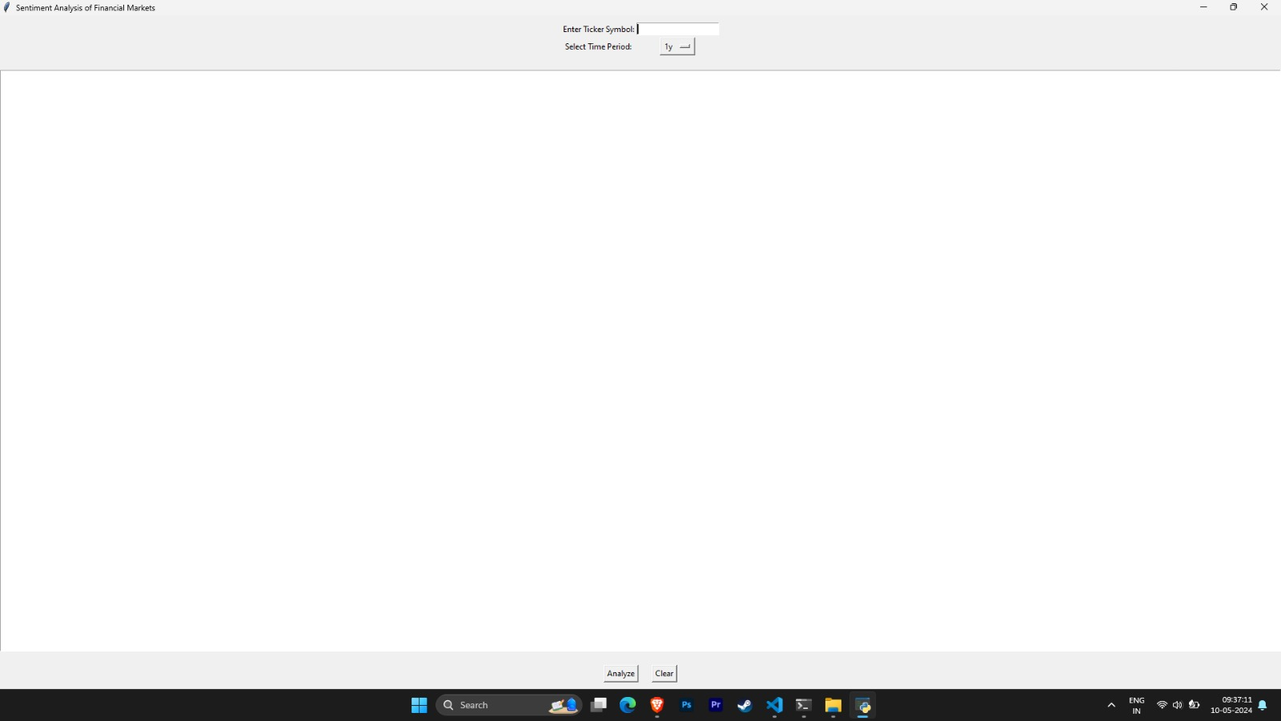
PROJECT OUTPUT

Slide 14
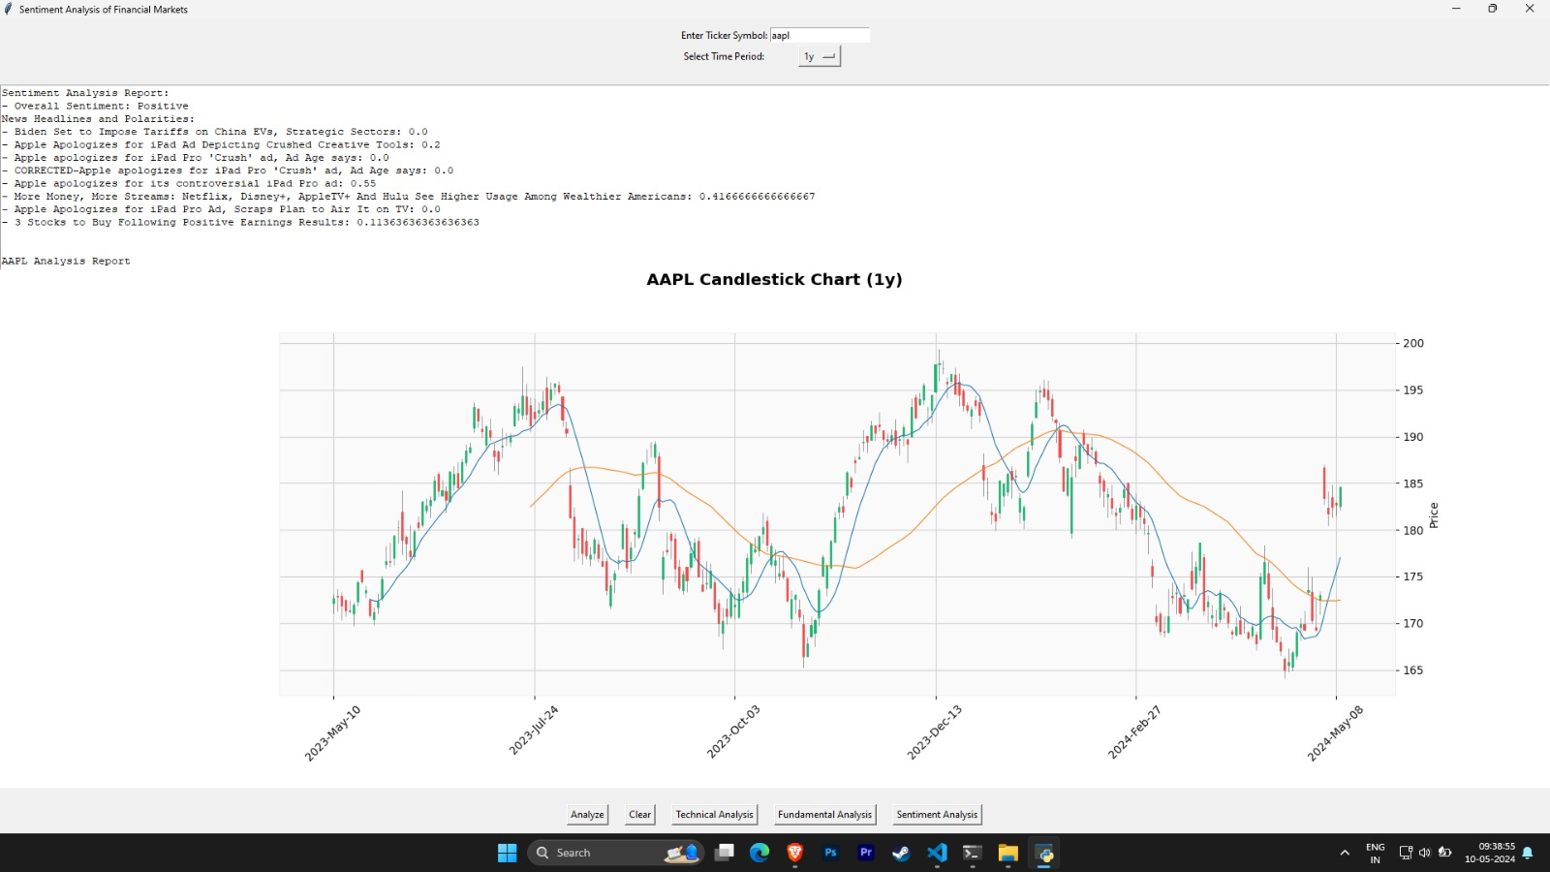

Slide 15
References:
Yfinance documentation, Moneycontrol,
S. Mohan, S. Mullapudi, S. Sammeta, P. Vijayvergia and D. C. Anastasiu, "Stock Price Prediction Using News Sentiment Analysis," 2019 IEEE Fifth International Conference on Big Data Computing Service and Applications (BigDataService)
Financial journals: ABI/INFORM , Business Source Complete.
B. Shivani and S. P. G. Rao, "Stock Market Analysis & Prediction," 2021 International Conference on Forensics, Analytics, Big Data, Security (FABS)

Slide 16
THANKYOU!

